Slide 1
Visualization of Landscape Changes using Synthesized Aerial Imagery
Felix Saaro
Semester Project
18. Oktober 2024, Zürich
Notes:
Introduction
My name is Felix
I am a part time master student in data science at the ZHAW
I work 50% as a research assistant at the Centre for Artificial Intelligence also at the ZHAW
Now the reason that i am here at PLUS is that in my semester project I not only want to develope the technical aspects of this project but also leverage the expertise that you have here to create something useful.
I belive that this combination of domain expetise and technical know-how makes the project very interessting to me

Slide 2
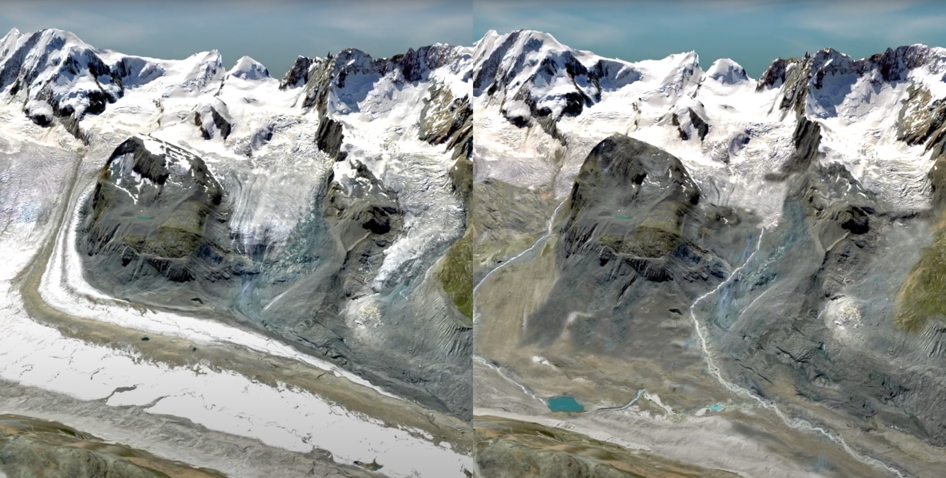
Idea
Build a tool that enables user to visualize landscape changes.
Aerial images could be generated from land use / land cover maps
Notes:
The idea to visualize landscape changes comes from a video that Julien Anet created ahead of the vote on the climate protection act in 2023
In a conversation with him he explained to me how tedious it was to photoshop the terrain, adjust the elevation map and combine it to create a 3d scene
We agreed that there must be an easier way to do this and that this can be useful not only to create appealing impressions but also to help communicating future changes in our environment.
The basic idea is to use the land use and land cover maps as an input to generate aerial images.

Slide 3
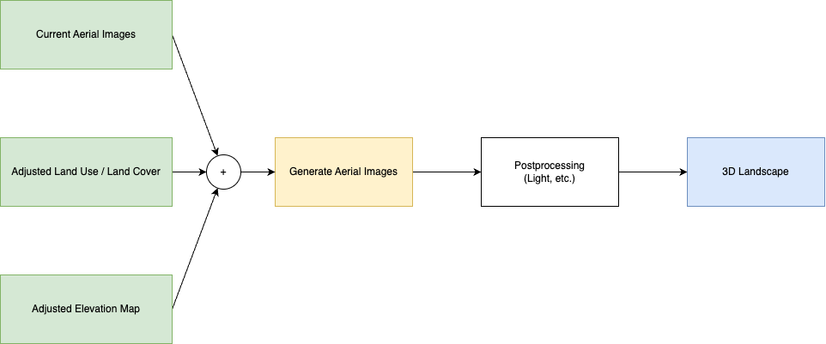
Proposal
Notes:
1. In this project I propose a tool that takes current aerial images, adjusted land use / land cover maps, and adjusted elevation maps to generate new aerial images.
2. The result is then combined with the new elevation map to create a 3d scene
3. With this tool, experts can adjust the land use / land cover maps as well as the elevation map by hand and then generate new aerial images from it.

Slide 4
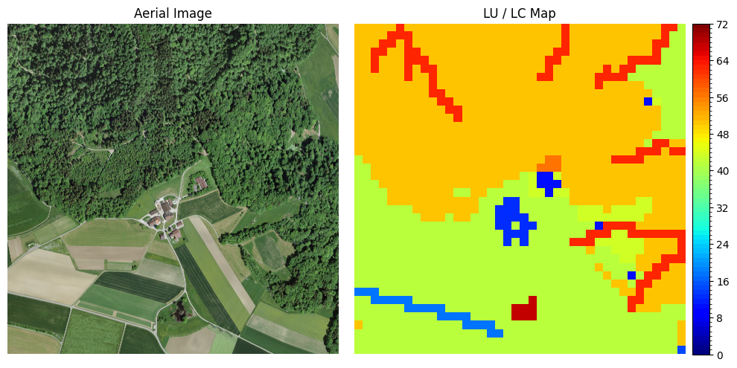
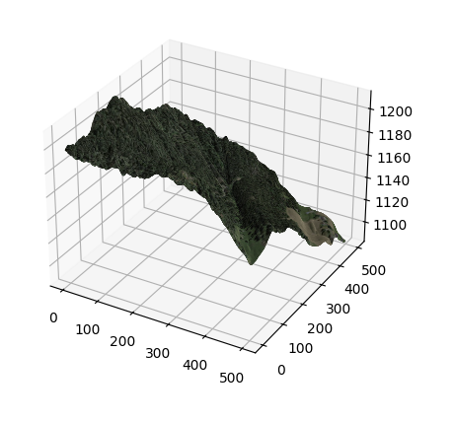
Data
SWISSIMAGE
0.1 m Resolution
Since 1946
Swiss Land Use Statistics (NOAS04)
100 m Resolution
Since 1972
72 Basic Categories
44 Categories in the EU (CORINE)
Combines Land use and Land Cover
Hand annotated, supported by ADELE Model
SWISSALTI3D
Elevation model without vegetation
0.5 m Resolution
Notes:
To generate aerial images from land use / land cover maps requires a lot of data
The gerneation is based on three publicly available datasets
SwissImage provides the aerial images with a resoltuion of 0.1m
The Swiss Land Use Statistics provide a map in which the 100m grid intersections are assigned to one of 72 classes (4 main classes, 17 sub classes, 27 sub-sub classes and 72 base classes)
Elevation model is provided with a 0.5m resolution without vegetation

Slide 5
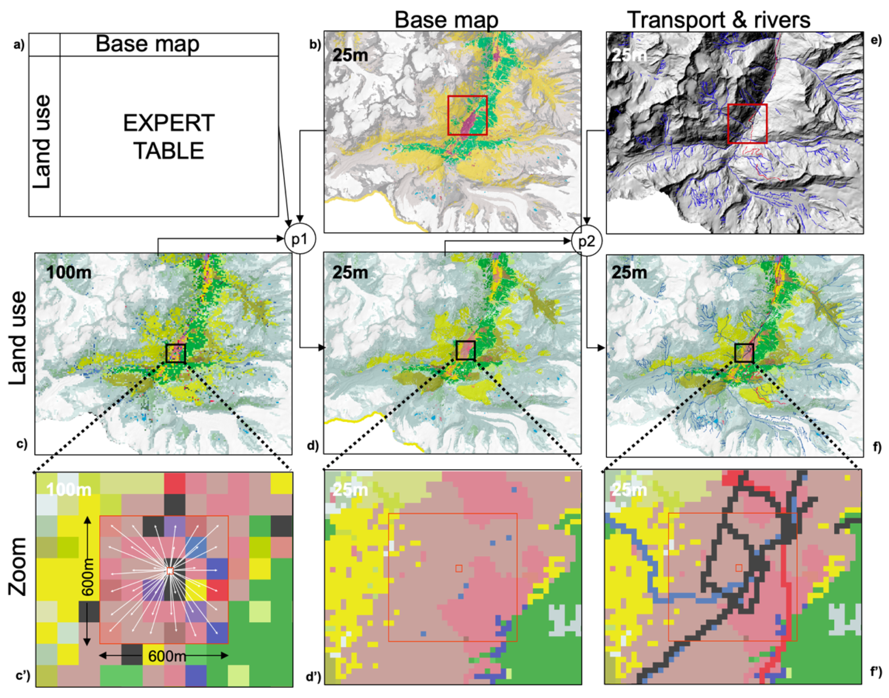
Improving the Land Use Statistic Maps
Downscaling method to 25 m resoltuion
Uses a combination of Nearest Neighbor and Export System
Can be automatically applied to 2024 Land Use Statistic Maps
Overlays linear features sucht as rivers, roads and rails
G. Giuliani, D. Rodila, N. Külling, R. Maggini, and A. Lehmann, “Downscaling Switzerland Land Use/Land Cover Data Using Nearest Neighbors and an Expert System,” Land, vol. 11, no. 5, Art. no. 5, May 2022, doi: 10.3390/land11050615.
Notes:
100m resolution for the land use land / cover map is not really ideal for what we want to achieve.
This map also doesn’t include linear features rivers or roads
A method proposed by Giuliani from the university of Geneva in 2022 down scales the map to a 25m grid and adds linear features

Slide 6
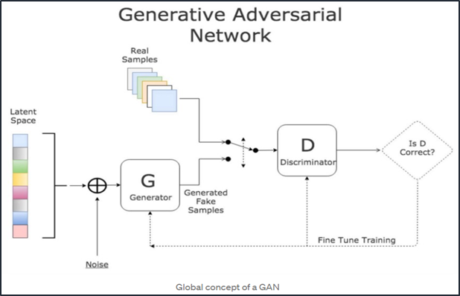
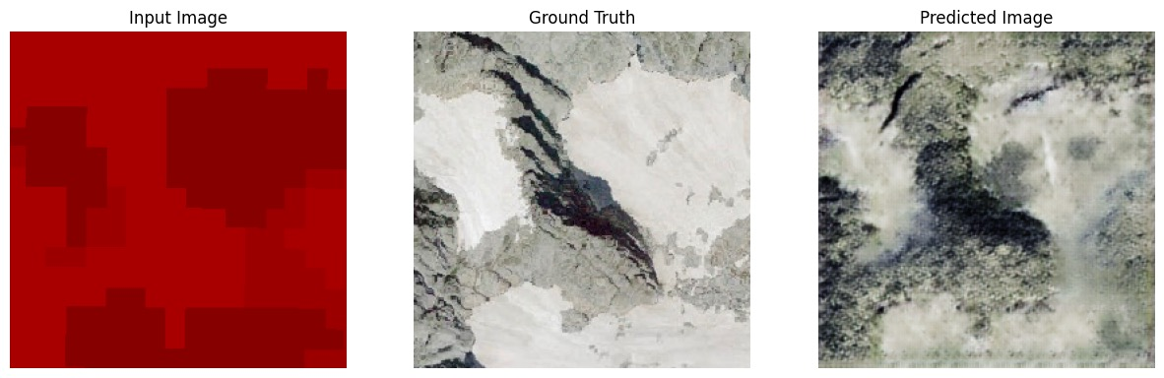
Methods: Generative adversarial networks
Image-to-Image Translation using a GAN
Pix2pix model
Trains a Generator and a Discriminator
Discriminator judges if the generated sample is passable
Generateor is an Encoder-Decoder Neural Network
Notes:
With all this we can start thinking about the generation
The first thing that came to my mind is using Generative adversarial networks
It is an established method that some might call outdated (2017)
It works by training two networks
One that generate images using an encoder-decoder NN
One that judges the generation to improve it
I tried training a pix2pix model and verified that this can work (overfitted, small sampel size)

Slide 7
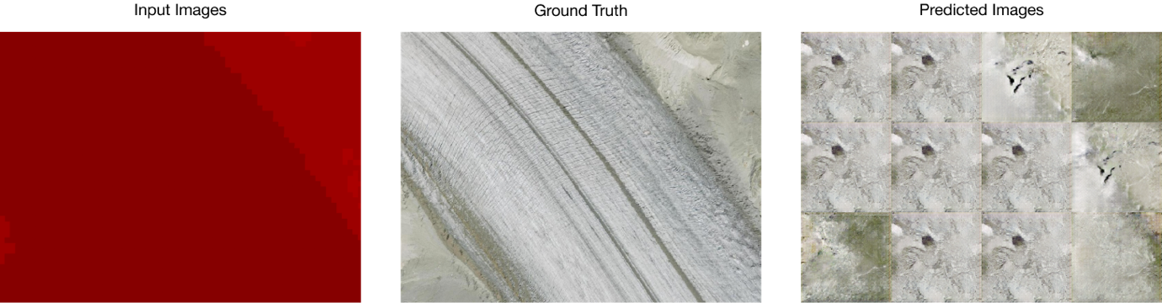
Methods: Generative adversarial networks
Tiles can only be generated independently
Without further processing or another generative model, the intersection between tiles are visible
Notes:
However the tiles that are generated are always independend of each other.
And this makes it very difficult to produce an image over a larger area.
Especially in this scenario where some tiles are entirely from 1 class.
The overfitted model is also not good at producing non deterministic results

Slide 8
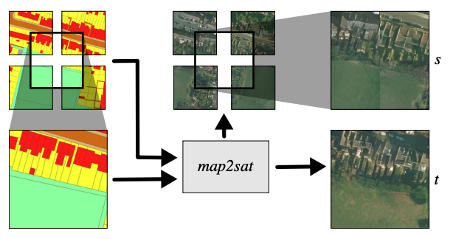
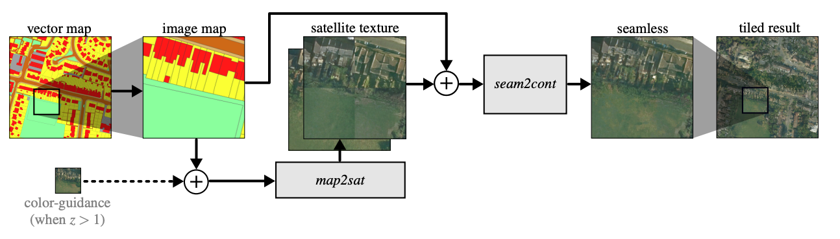
Methods: Generative adversarial networks
Samless Satellite-image Synthesis method is developed to remove these boarders
Uses two networks
Map2sat to generate a single tile
Seam2cont to combine image map and generated tile
J. Zhu and T. Kelly, “Seamless Satellite-image Synthesis.” arXiv, Nov. 05, 2021. doi: 10.48550/arXiv.2111.03384.
Notes:
Luckily this problem was already tackled in 2021 by Zhu and Kelly.
They propose a 2 stage process with 2 networks
One to generate the individual tiles
And one that can combine them
Ther seam2cont network applies a circular mask to the individual tiles and uses the masked image to generate a new coherent one.

Slide 9
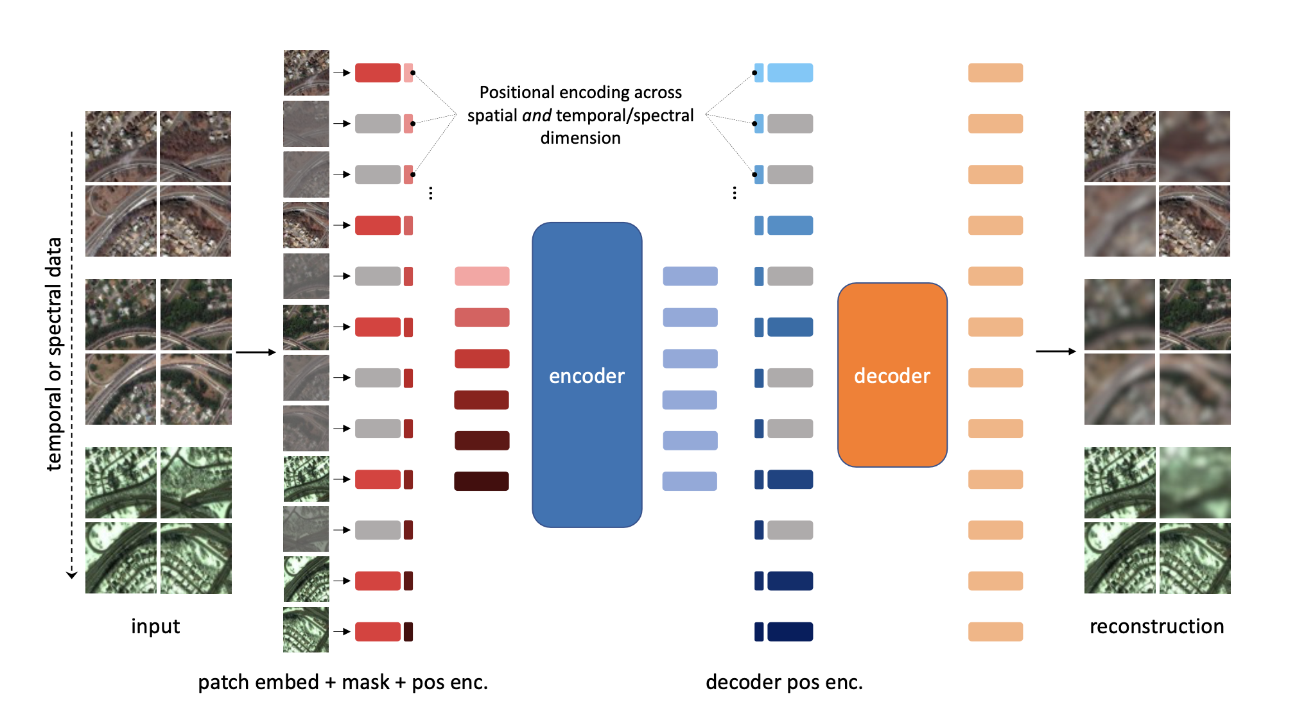
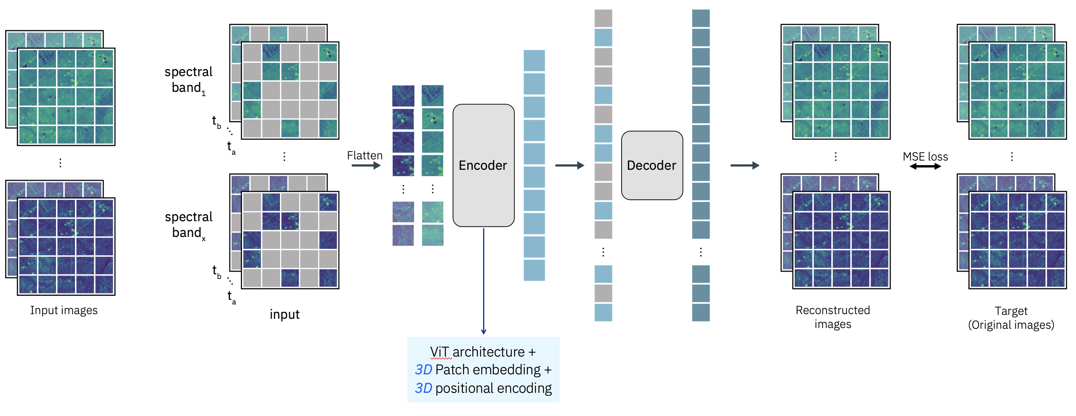
Methods: Masked Autoencoders
Generallz a encoder decoder neural network
Trained to reconstruct masked images
Extensive research in this area
SatMAE (Standford)
ScaleMAE (UC Berkeley, Meta)
Prithvi (IBM Research, NASA)
Models require a lot of training data to work well
Generate continous images is an inherent property
C. J. Reed et al., “Scale-MAE: A Scale-Aware Masked Autoencoder for Multiscale Geospatial Representation Learning.” arXiv, Sep. 21, doi: 10.48550/arXiv.2212.14532
Y. Cong et al., “SatMAE: Pre-training Transformers for Temporal and Multi-Spectral Satellite Imagery.” arXiv, Jan. 15, 2023. doi: 10.48550/arXiv.2207.08051.
J. Jakubik et al., “Foundation Models for Generalist Geospatial Artificial Intelligence.” arXiv, Nov. 08, 2023. doi: 10.48550/arXiv.2310.18660.
Notes:
Most reasearch in the past 2 years has been focused on using masked autoencoders to generate aerial images.
However they require a lot of data to be trained.
This is a method where the encoder-decoder NN (more specifically a vision transformer) is trained on masked images to reconstruct the originals.
It is shown that this method works well, especially the Prithvi Models published by IBM Research and NASA. These models are open source and can be fine tuned for downstream tasks susch as segmentation.
It remains uncertain if this could be fine tuned with the aerial images since the original models use multi-band immages with additional ir-channels.

Slide 10
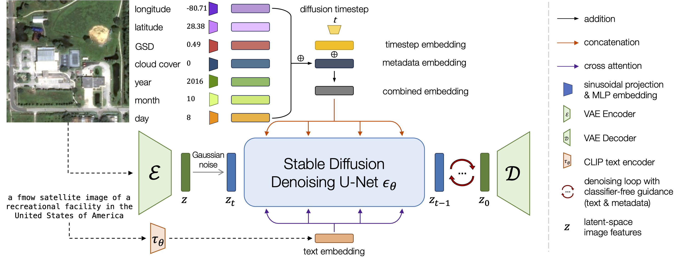
Methods: Diffusion
Few attempts to generate satellite images using diffusion
DiffusionSat (Standford)
Labeled dataset with textual description
Enhanced with numerical metadata
Makes use of the original stabel diffusion architecture in addition to an encoder decoder architecture
S. Khanna et al., “DiffusionSat: A Generative Foundation Model for Satellite Imagery.” arXiv, Dec. 06, 2023. doi: 10.48550/arXiv.2312.03606.
Notes:
The team behind SatMAE has proposed in its newest publication a method that utilizes a diffusion to generate the iamges.
This method is a combination of Autoencoders (Encoder/Decoder) and the Stable Diffusion architecture (U-NET)
A textual prompt provides guidence during the generation and some additional metadata such as the geographical position and the recorded date.
For the use case I am working on it is not yet interessting to use textual prompts. However it could be interessting to use a combination of land use / land cover data and a text prompt (e.g. Add an Alpine Solar Farm)

Slide 11

Proposed Method
Start with a diffusion based method utilizing a U-Net architecture
Conditioned on land use map
Two step mehod
Generate low resolution tiles over a larger area (e.g. 4 tiles)
Generate high resolution tiles using the low resolution tile
Notes:
I decided to start with a similar approach. Using a very basic diffusion method with a U-Net architecture to generate the images.
The only enhancement to this method that I will be doing from the start is the conditioning on the land use / land cover maps.
To overcome the tiling issue I want to improve the model to take a pre generate image as an input. This way I can first generate a low resoltuion tile of a larger area (2x2 tiles) and take that as an input to create the high resolution tiles.
The cool thing with diffusion is that we do not have to take noise as a starting point to generate the image. The low resolution image can already be used and then improved step by step.

Slide 12
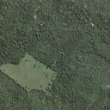

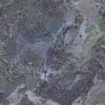
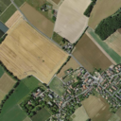
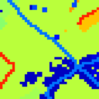
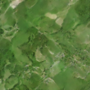
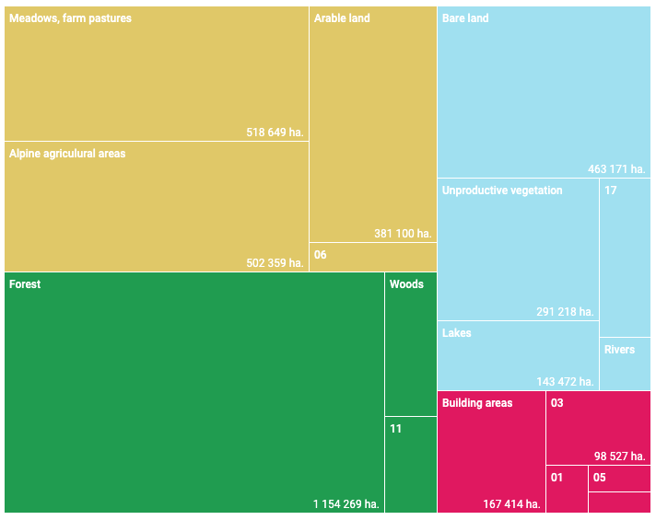
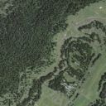
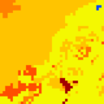
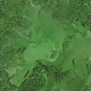
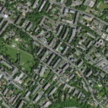
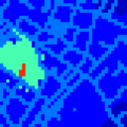
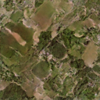
Proposed Method
Original
Segmented
Generated
Simple U-Net architecture with conditional generation produces good results on small training sets
1000 samples
50 training epochs
Inequal class distribution
Notes:
The first implementation has shown some prosmising results.
To verify the implementation I trained the u-net on 1000 samples and 50 epochs
Notes
Linear features are not easy to generate, probably because they occure infrequrently.
Forest, nbare land and farm land is relatively easy to generate.
However I have to consider that the class distirbution is highly inequal (30% forest)
And with this I want open the discussion.
Thank you for your attention!

Slide 13
Discussion

